Slide 1

AI AND CARS
danger of autopilot
Презентацию выполнил студент РГПУ ИВТ 1-ой группый 1-ой подгруппы Лабырин Матвей

Slide 2
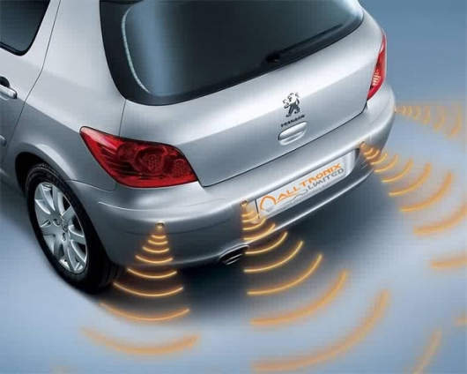
How does autopilot works?
1. Ultrasonic sensors
These sensors determine distances to other objects using sent ultrasound, which, reflected from objects, goes back to the sensors. Thanks to the speed of the signal passing back and forth, the distance to objects is determined.

Slide 3
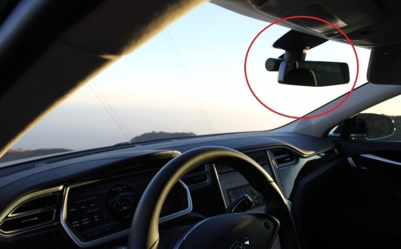
2. Camcorders
In cars with autopilot systems, cameras are usually mounted above the inside rearview mirror in the upper center of the windshield. These cameras are used for lane control systems. The camera data transmits frame-by-frame an overview of the road with lanes to a computer, which, analyzing the frames received, identifies each line of the road marking on the highway. So the computer determines if the car is moving inside the lanes. Also, these cameras can be used for emergency braking systems and identification of road signs.

Slide 4
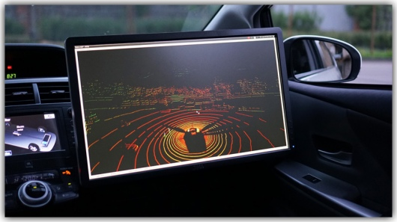
3. Radar sensors
The cameras give a good general overview of the environment around the car, but in order to turn this vision into real three-dimensional space, complex computer calculation is required. Higher mathematics comes to the rescue. Radar sensors are used to help the computer determine how far the car is from other cars and objects around it.

Slide 5
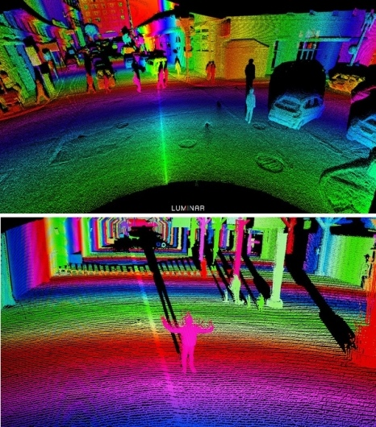
4. Lidar
Lidar determines the direction and range of light. That is, in fact, lidar is a kind of light-based radar. Lidar uses low-intensity, harmless and invisible laser beams that are directed toward the target. Most autonomous cars use lidar, which emits laser beams around the car a full 360 °

Slide 6
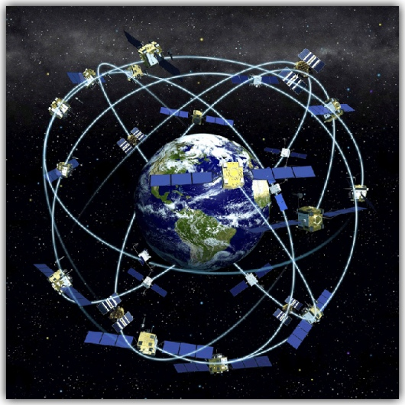
5. GPS
The Global Positioning System (GPS), or the Global Navigation Satellite System (GLONASS), is based on satellites orbiting the Earth to know exactly where we are. All autonomous cars in the future will use these systems not only for navigation, but simply for driving without the driver’s participation.

Slide 7
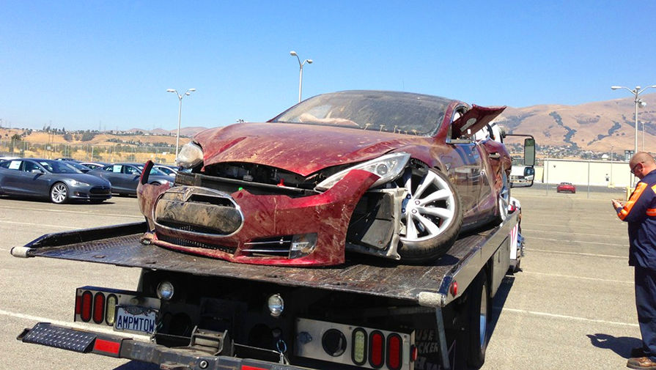
Danger and causes of distrust
•In May 2016, the owner of a Tesla car died in a car accident, crashing into a truck. Alleged reason - the autopilot took the truck for a traffic sign.
After this incident, public confidence in autopilot declined dramatically.

Slide 8
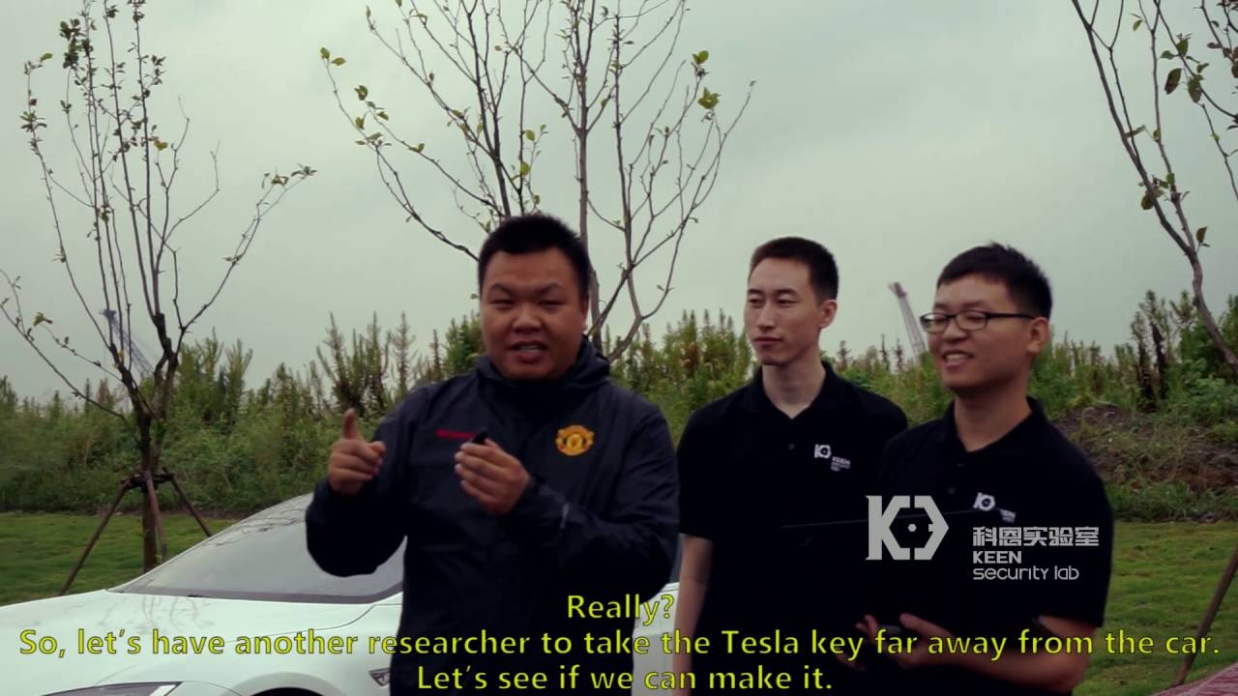
Danger of hacking by hackers. Tesla's cars have already been hacked several times by hackers from Tencent Keen Security.

Slide 9
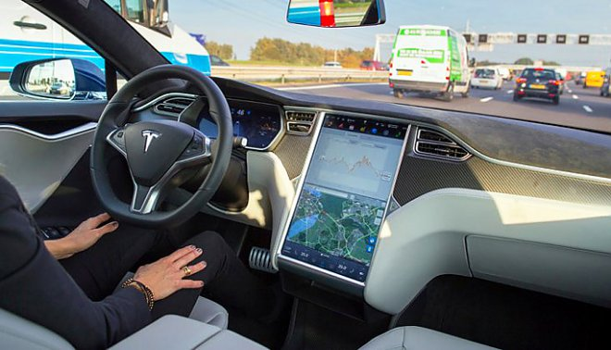
The ethical part of the question: when a car with an autopilot has a choice: to knock down a pedestrian or crash into a pole, endangering the life of the driver, what should he choose?
States should also decide who should be held responsible for the accident: a “driver” who could take control or the manufacturer.

Slide 10
But if you look at the numbers, you can already say that the autopilot copes with its task quite successfully. Today, there are about 150,000 autopilot cars in the world, their total mileage (during the included autopilot mode) between 2015 and 2016 amounted to 357 million kilometers. For example, if in Russia all cars would drive on autopilot for one year, then not 23 thousand people would die in car crashes in a year, but only 3 thousand.

Slide 11
summarizing
It can be summarized that although the public does not trust the autopilot systems too much, the future lies with them. Riding with an autopilot is safer now than with a living person driving, and every year technology moves forward.

